Slide 1

Operating Systems Design​ Session 33: Message Queue Interprocess communication
19CS2106R​
© 2020 KL University

Slide 2
UNIX provides several different IPC mechanisms.
Interprocess interactions have several distinct purposes:
Data transfer — One process may wish to send data to another process. The amount of data sent may vary from one byte to several megabytes.
Sharing data — Multiple processes may wish to operate on shared data, such that if a process modifies the data, that change will be immediately visible to other processes sharing it.
Event notification — A process may wish to notify another process or set of processes that some event has occurred. For instance, when a process terminates, it may need to inform its parent process. The receiver may be notified asynchronously, in which case its normal processing is interrupted. Alternatively, the receiver may choose to wait for the notification.
Resource sharing — Although the kernel provides default semantics for resource allocation, they are not suitable for all applications. A set of cooperating processes may wish to define their own protocol for accessing specific resources. Such rules are usually implemented by a locking and synchronization scheme, which must be built on top of the basic set of primitives provided by the kernel.
Process control — A process such as a debugger may wish to assume complete control over the execution of another (target) process. The controlling process may wish to intercept all traps and exceptions intended for the target and be notified of any change in the target's state.

Slide 3
Interprocess Communication
Processes have to communicate to exchange data and to synchronize operations. Several forms of interprocess communication are: pipes, named pipes and signals. But each one has some limitations.
System V IPC
The UNIX System V IPC package consists of three mechanisms:
Message Queues/Messages allow process to send formatted data streams to arbitrary processes.
Shared memory allows processes to share parts of their virtual address space. an area of memory accessible by multiple processes.
Semaphores allow processes to synchronize execution. Can be used to implement critical-section problems; allocation of resources.

Slide 4

IPC System Calls
Functionality | Message Queue | Semaphore | Shared Memory
Allocate IPC | msgget | semget | shmget
Access IPC | msgsnd msgrcv | semop | shmat shmdt
IPC Control | msgctl | semctl | shmctl
msg/sem/shm get
Create new or open existing IPC structure.
Returns an IPC identifier
msg/sem/shm ctl
Determine status, set options and/or permissions
Remove an IPC identifier
msg/sem/shm op
Operate on an IPC identifier
For example(Message queue)
add new msg to a queue (msgsnd)
receive msg from a queue (msgrcv)

Slide 5
They share common properties:
Each mechanism contains a table whose entries describe all instances of the mechanism.
Each entry contains a numeric key, which is its user-chosen name.
Each mechanism contains a "get" system call to create a new entry or to retrieve an existing one, and parameters to the calls include a key and flags.
Processes can call the "get" system calls with the key IPC_PRIVATE to assure the return of an unused entry. They can set the IPC_CREAT bit in the flag field to create a new entry if one by the given key does not already exist, and they can force an error notification by setting the IPC_EXCL and IPC_CREAT flags, if an entry already exists for the key.
The kernel uses the following formula to find the index into the table of data structures from the descriptor: index = descriptor modulo (number of entries in table);
Each entry has a permissions structure that includes the user ID and group ID of the process that created the entry, a user and group ID set by the "control" system call (studied below), and a set of read-write-execute permissions for user, group, and others, similar to the file permission modes.
Each entry contains other information such as the process ID of the last process to update the entry, and time of last access or update.

Slide 6
They share common properties:
Each mechanism contains a "control" system call to query status of an entry, to set status information, or to remove the entry from the system.
When a user allocates an IPC resource, the kernel returns the resource ID or descriptor , which it computes by the formula
Id or descriptor = seq * table size + index;
where seq is the sequence number of this resource, table size is the size of the resource table, and index is the index of the resource in the table. This ensures that a new id is generated if a table element is reused, since seq is incremented. This prevents processes from accessing a resource using a stale id.
For example, if the table of message structures contains 100 entries, the descriptors for entry 1 are 1, 101, 201, and so on. When a process removes an entry, the kernel increments the descriptor associated with it by the number of entries in the table: The incremented value becomes the new descriptor for the entry when it is next allocated by a "get" call. Processes that attempt to access the entry by its old descriptor fail on their access. Referring to the previous example, if the descriptor associated with message entry 1 is 201 when it is removed, the kernel assigns a new descriptor, 301, to the entry. Processes that attempt to access descriptor 201 receive an error, because it is no longer valid. The kernel eventually recycles descriptor numbers, presumably after a long time lapse.

Slide 7
Messages/Message Queues
There are four system calls for messages/messages queues:
msgget returns (and possibly creates) a message descriptor.
msgctl has options to set and return parameters associated with a message descriptor and an option to remove descriptors.
msgsnd sends a message.
msgrcv receives a message.

Slide 8
Permission Structure
ipc_perm is associated with each IPC structure.
Defines the permissions and owner.
struct ipc_perm {
uid_t uid; /* owner's effective user id */
gid_t gid; /* owner's effective group id */
uid_t cuid; /* creator's effective user id */
gid_t cgid; /* creator’s effective group id */
mode_t mode; /* access modes */
ulong seq; /* slot usage sequence number */
key_t key; /* key */
};

Slide 9
Message Queues
One process establishes a message queue that others may access. Often a server will establish a message queue that multiple clients can access
Features of Message Queues
A process generating a message may specify its type when it places the message in a message queue.
Another process accessing the message queue can use the message type to selectively read only messages of specific type(s) in a first-in-first-out manner.
Message queues provide a user with a means of multiplexing data from one or more producer(s) to one or more consumer(s).

Slide 10
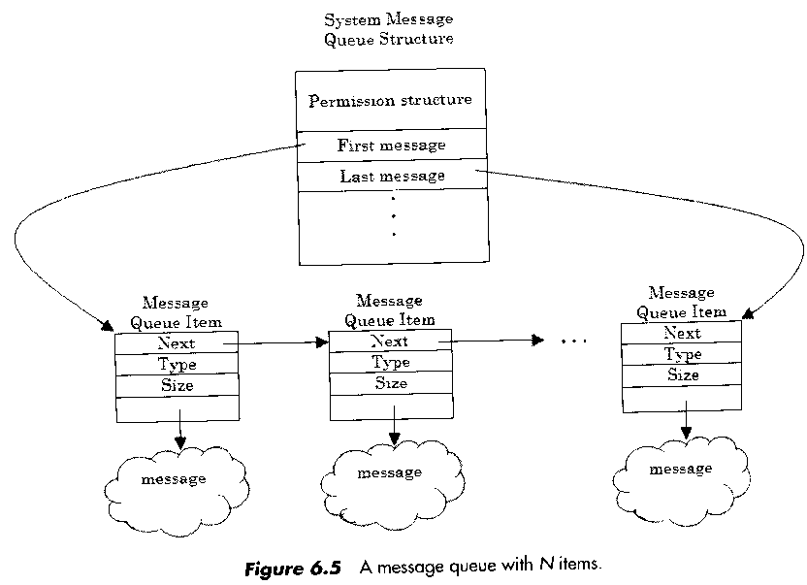
Message Queue Structure

Slide 11
Message Queues
Each queue has a structure
struct msqid_ds {
struct ipc_perm msg_perm;
struct msg *msg_first; /* ptr to first msg on queue */
struct msg *msg_last; /* ptr to last msg on queue */
ulong msg_cbytes; /* current # bytes on queue */
ulong msg_qnum; /* # msgs on queue */
ulong msg_qbytes; /* max # bytes on queue */
pid_t msg_lspid; /* pid of last msgsnd() */
pid_t msg_lrpid; /* pid of last msgrcv() */
time_t msg_stime; /* last-msgsnd() time */
time_t msg_rtime; /* last-msgrcv() time */
time_t msg_ctime; /* last-change time */
};
We can get the structure using msgctl() function.
Actually, however, we don’t need to know the structure in detail.

Slide 12
Syntax of msgget:
msgqid = msgget(key, flag);
where msgqid is the descriptor returned by the call, and key and flag have the semantics described above for the general "get" calls. The kernel stores messages on a linked list (queue) per descriptor, and it uses msgqid as an index into an array of message queue headers. The queue structure contains the following fields, in addition to the common fields:
Pointers to the first and last messages on a linked list.
The number of messages and total number of data bytes on the linked list.
The maximum number of bytes of data that can be on the linked list.
The process IDs of the last processes to send and receive messages.
Time stamps of the last msgsnd, msgrcv, and msgctl operations.

Slide 13
Syntax of msgget:
#include <sys/types.h>
#include <sys/ipc.h>
#include <sys/msg.h>
int msgget(key_t key, int flag);
Returns: msg queue ID if OK, -1 on error
Create new or open existing queue
flag : ipc_perm.mode
Example
msg_qid = msgget(DEFINED_KEY, IPC_CREAT | 0666);

Slide 14
Syntax of msgsnd:
/* Algorithm: msgsnd
* Input: message queue descriptor
* address of message structure
* size of message
* flags
* Output: number of bytes send
*/
{ check legality of descriptor, permissions;
while (not enough space to store message)
{
if (flags specify not to wait)
return;
sleep(event: enough space is available);
}
get message header;
read message text from user space to kernel;
adjust data structures: enqueue message header,
message header points to data, counts,
time stamps, process ID;
wakeup all processes waiting to read message from queue;
}
msgsnd(msgqid, msg, count, flag);
flag describes the action the kernel should take if it runs out of internal buffer space. The algorithm is given below:

Slide 15
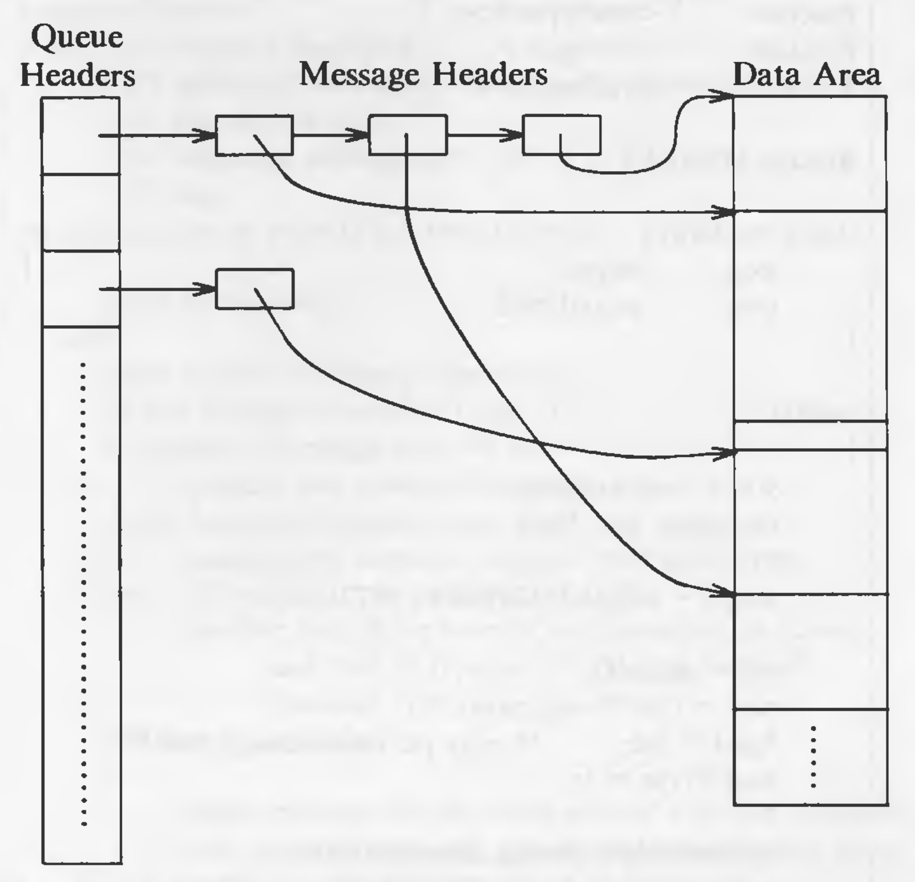
The diagram shows the structure of message queues:

Slide 16
msgsnd()
#include <sys/types.h>
#include <sys/ipc.h>
#include <sys/msg.h>
int msgsnd(int msqid, const void *ptr, size_t nbytes, int flag);
Returns: 0 if OK, -1 on error
msgsnd() places a message at the end of the queue.
ptr: pointer that points to a message
nbytes: length of message data
if flag = IPC_NOWAIT: IPC_NOWAIT is similar to the nonblocking I/O flag for file I/O.
Structure of messages
struct mymesg {
long mtype; /* positive message type */
char mtext[512]; /* message data, of length nbytes */
};

Slide 17
Syntax for msgrcv:
/* Algorithm: msgrcv
* Input: message descriptor
* address of data array for incoming message
* size of data array
* requested message type
* flags
* Output: number of bytes in returned message
*/
{ check permissions;
loop:
check legality of message descriptor;
// find message to return to user
if (requested message type == 0)
consider first message on queue;
else if (requested message type > 0)
consider first message on queue with given type;
else // requested message type < 0
consider first of the lowest typed messages on queue,
such that its type is <= absolute value of requested type;
if (there is a message)
{ adjust message size or return error if user size too small;
copy message type, text from kernel space to user space;
unlink message from queue;
return;
}
// no message
if (flags specify not to sleep)
return with error;
sleep(event: message arrives on queue);
goto loop;
}
count = msgrcv(id, msg, maxcount, type, flag);

Slide 18
msgrcv()
#include <sys/types.h>
#include <sys/ipc.h>
#include <sys/msg.h>
int msgrcv(int msqid, void *ptr, size_t nbytes, long type, int flag);
Returns: data size in message if OK, -1 on error
msgrcv() retrieves a message from a queue.
type == 0: the first message on the queue is returned
type > 0: the first message on the queue whose message type equals type is returned
type < 0: the first message on the queue whose message type is the lowest value less than or equal to the absolute value of type is returned
flag may be given by IPC_NOWAIT

Slide 19
Algorithm: msgrcv
If processes were waiting to send messages because there was no room on the list, the kernel awakens them after it removes a message from the message queue. If a message is bigger than maxcount, the kernel returns an error for the system call leaves the message on the queue. If a process ignores the size constraints (MSG_NOERROR bit is set in flag), the kernel truncates the message, returns the requested number of bytes, and removes the entire message from the list.
If the type is a positive integer, the kernel returns the first message of the given type. If it is a negative, the kernel finds the lowest type of all message on the queue, provided it is less than or equal to the absolute value of the type, and returns the first message of that type. For example, if a queue contains three messages whose types are 3, 1, and 2, respectively, and a user requests a message with type -2, the kernel returns the message of type 1.

Slide 20
The syntax of msgctl:
msgctl(id, cmd, mstatbuf);
where cmd specifies the type of command, and mstatbuf is the address of a user data structure that will contain control parameters or the results of a query.
#include <sys/types.h>
#include <sys/ipc.h>
#include <sys/msg.h>
int msgctl(int msqid, int cmd, struct msqid_ds *buf);
Returns: 0 if OK, -1 on error
Performs various operations on a queue
cmd = IPC_STAT: fetch the msqid_ds structure for this queue, storing it in buf
cmd = IPC_SET: set the following four fields from buf: msg_perm.uid, msg_perm.gid, msg_perm.mode, and msg_qbytes
cmd = IPC_RMID: remove the message queue.

Slide 21
example: sender.c – send/store 3 messages in to MQ
#include <stdio.h> // sender.c
#include <sys/types.h>
#include <sys/ipc.h>
#include <sys/msg.h>
#define DEFINED_KEY 0x10101010
main(int argc, char **argv)
{
int msg_qid;
struct {
long mtype;
char content[256];
} msg;
fprintf(stdout, "=========SENDER==========\n");
if((msg_qid = msgget(DEFINED_KEY, IPC_CREAT | 0666)) < 0) {
perror("msgget: "); exit(-1);
}
msg.mtype = 1; int i=3;
while(i--) {
memset(msg.content, 0x0, 256);
gets(msg.content);
if(msgsnd(msg_qid, &msg, sizeof(msg.content), 0) < 0) {
perror("msgsnd: "); exit(-1);
}
}
}

Slide 22
example: receiver.c – fetch 3 messages from MQ
#include <stdio.h> // receiver.c
#include <sys/types.h>
#include <sys/ipc.h>
#include <sys/msg.h>
#define DEFINED_KEY 0x10101010
main(int argc, char **argv)
{
int msg_qid;
struct {
long mtype;
char content[256];
} msg;
fprintf(stdout, "=========RECEIVER==========\n");
if((msg_qid = msgget(DEFINED_KEY, IPC_CREAT | 0666)) < 0) {
perror("msgget: "); exit(-1);
}
int i=3;
while(i--) {
memset(msg.content, 0x0, 256);
if(msgrcv(msg_qid, &msg, 256, 0, 0) < 0) {
perror("msgrcv: "); exit(-1);
}
puts(msg.content);
}
}

Slide 23
Execute sender.c and receiver.c on two different terminals
[vishnu@team-osd ~]$ vi sender.c
[vishnu@team-osd ~]$ cc sender.c -o sender
[vishnu@team-osd ~]$ ./sender
=========SENDER==========
i
am
happy
[vishnu@team-osd ~]$ vi receiver.c
[vishnu@team-osd ~]$ cc receiver.c -o receiver
[vishnu@team-osd ~]$ ./receiver
=========RECEIVER==========
i
am
happy

Slide 24
Thank you

